Slide 1




Computer Networks
OSI Transport Layer Protocols
Lecturer: Sura F. Ismail
Lecture Six
Second Class.
Time: 9: 30- 11:30
Department: Informatics Systems Management (ISM)

Slide 2
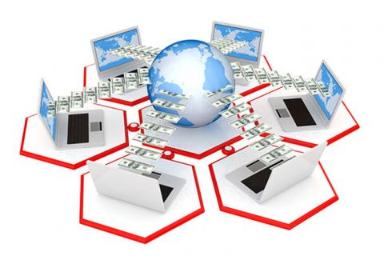
Outline
Outline
TCP: Communicating with Reliability
UDP: Communicating with Low Overhead

Slide 3
1. TCP: Communicating with Reliability
Outline
TCP is often referred to as a connection-oriented protocol, a protocol that guarantees reliable and in-order delivery of data from sender to receiver. In the following sections, you explore how this is managed. Connection establishment and termination are discussed, along with the use of three-way handshake. Flow control, the use of windowing as congestion control, and retransmission of data are presented.

Slide 4
1. TCP: Communicating with Reliability
Outline
Making Conversations Reliable
The key distinction between TCP and UDP is reliability. The reliability of TCP communication is performed using connection-oriented sessions. Before a host using TCP sends data to another host, the transport layer initiates a process to create a connection with the destination. This connection enables the tracking of a session, or communication stream, between the hosts. This process ensures that each host is aware of and prepared for the communication. A complete TCP conversation requires the establishment of a session between the hosts in both directions.
After a session has been established, the destination sends acknowledgments to the source for the segments that it receives.
Part of the additional overhead of using TCP is the network traffic generated by acknowledgments and retransmissions.

Slide 5
1. TCP: Communicating with Reliability
Outline
TCP Server Processes
As discussed previously, application processes run on servers. These processes wait until a client initiates communication with a request for information or other services.
Each application process running on the server is configured to use a port number, either by default or manually by a system administrator. An individual server cannot have two services assigned to the same port number within the same transport layer services. A host running a web server application and a file transfer application cannot have both configured to use the same port (for example, TCP port 8080).
When an active server application is assigned to a specific port, that port is considered to be “open” on the server. This means that the transport layer accepts and processes segments addressed to that port. Any incoming client request addressed to the correct socket is accepted, and the data is passed to the server application. There can be many simultaneous ports open on a server, one for each active server application. It is common for a server to provide more than one service, such as a web server and an FTP server, at the same time.

Slide 6
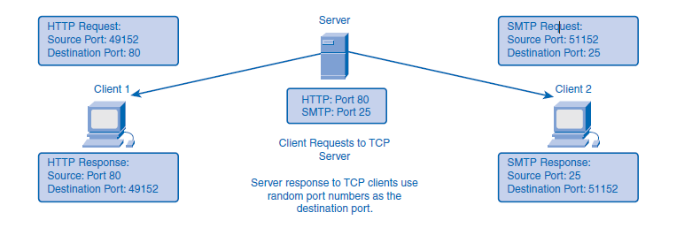
1. TCP: Communicating with Reliability
Outline

Slide 7
1. TCP: Communicating with Reliability
Outline
TCP Connection Establishment and Termination
When two hosts communicate using TCP, a connection is established before data can be exchanged. After the communication is completed, the sessions are closed and the connection is terminated. The connection and session mechanisms enable TCP’s reliability function.
TCP Three-Way Handshake
The host tracks each data segment within a session and exchanges information about what data is received by each host using the information in the TCP header. Each connection represents two one-way communication streams, or sessions. To establish the connection, the hosts perform a three-way handshake. Control bits in the TCP header indicate the progress and status of the connection. The three-way handshake performs the following functions:
Establishes that the destination device is present on the network
Verifies that the destination device has an active service and is accepting requests on the destination port number that the initiating client intends to use for the session
Informs the destination device that the source client intends to establish a communication session on that port number

Slide 8
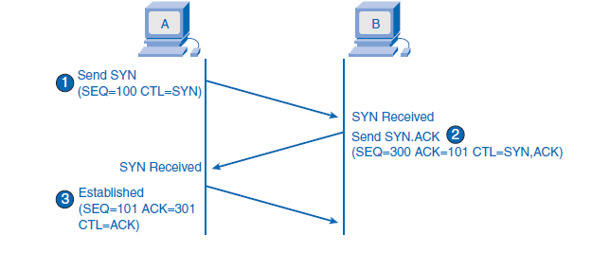
1. TCP: Communicating with Reliability
Outline

Slide 9
1. TCP: Communicating with Reliability
Outline
To understand the three-way handshake process, it is important to look at the various values that the two hosts exchange. Within the TCP segment header, the following six 1-bit fields contain control information used to manage the TCP processes:
URG: Urgent pointer field significant
ACK: Acknowledgment field significant
PSH: Push function
RST: Reset the connection
SYN: Synchronize sequence numbers
FIN: No more data from sender
These fields are referred to as flags, because the value of one of these fields is only 1 bit and, therefore, has only two values: 1 or 0. When a bit value is set to 1, it indicates what control information is contained in the segment.

Slide 10
1. TCP: Communicating with Reliability
Outline
TCP Session Termination
To close a connection, the FIN control flag in the segment header must be set. To end each one-way TCP session, a two-way handshake is used, consisting of a FIN segment and an ACK segment. Therefore, to terminate a single conversation supported by TCP, four exchanges are needed to end both sessions:
When the client has no more data to send in the stream, it sends a segment with the FIN flag set.
The server sends an ACK to acknowledge the receipt of the FIN to terminate the session from client to server.
The server sends a FIN to the client, to terminate the server-to-client session.
The client responds with an ACK to acknowledge the FIN from the server.

Slide 11
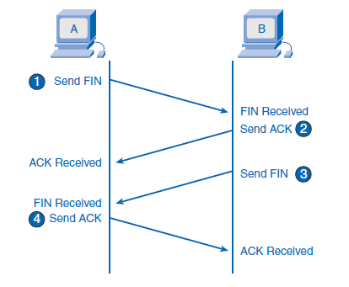
1. TCP: Communicating with Reliability
Outline

Slide 12
1. TCP: Communicating with Reliability
Outline
TCP Acknowledgment with Windowing
One of TCP’s functions is to make sure that each segment reaches its destination. The TCP services on the destination host acknowledge the data that they have received to the source application. The segment header sequence number and acknowledgment number are used together to confirm receipt of the bytes of data contained in the segments.
The sequence number indicates the relative number of bytes that have been transmitted in this session, including the bytes in the current segment. TCP uses the acknowledgment number in segments sent back to the source to indicate the next byte in this session that the receiver expects to receive. This is called expectational acknowledgment.

Slide 13
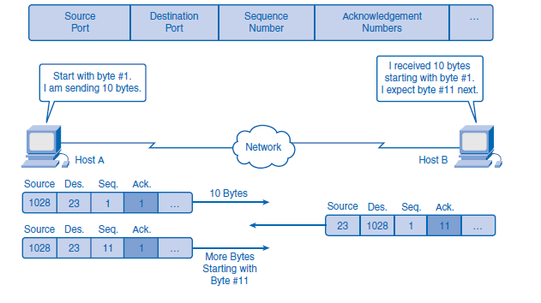
1. TCP: Communicating with Reliability
Outline

Slide 14
1. TCP: Communicating with Reliability
Outline
Looking at this example, if host A had to wait for acknowledgment of the receipt of each 10 bytes, the network would have a lot of overhead. To reduce the overhead of these acknowledgments, multiple segments of data can be sent and acknowledged with a single TCP message in the opposite direction. This acknowledgment contains an acknowledgment number based on the total number of segments received in the session.
For example, starting with a sequence number of 2000, if 10 segments of 1000 bytes each were received, an acknowledgment number of 12001 would be returned to the source. The amount of data that a source can transmit before an acknowledgment must be received is called the window size.
Window size is a field in the TCP header that enables the management of lost data and flow control.

Slide 15
1. TCP: Communicating with Reliability
Outline
TCP Retransmission
No matter how well designed a network is, data loss will occasionally occur. Therefore, TCP provides methods of managing these segment losses, including a mechanism to retransmit segments with unacknowledged data. A destination host service using TCP usually only acknowledges data for contiguous sequence bytes. If one or more segments are missing, only the data in the segments that complete the stream is acknowledged. For example, if segments with sequence numbers 1500 to 3000 and 3400 to 3500 were received, the acknowledgment number would be 3001, because segments with the sequence numbers 3001 to 3399 have not been received. When TCP at the source host has not received an acknowledgment after a predetermined amount of time, it will go back to the last acknowledgment number that it received and retransmit data from that point forward.
Hosts today can also employ an optional feature called selective acknowledgments. If both hosts support selective acknowledgments, it is possible for the destination to acknowledge bytes in noncontiguous segments, and the host would only need to retransmit the missing data.

Slide 16
1. TCP: Communicating with Reliability
Outline
TCP Congestion Control: Minimizing Segment Loss
TCP provides congestion control through the use of flow control and dynamic window sizes.
Flow Control
Flow control assists the reliability of TCP transmission by adjusting the effective rate of data flow between the two services in the session. When the source is informed that the specified amount of data in the segments is received, it can continue sending more data for this session.
The window size field in the TCP header specifies the amount of data that can be transmitted before an acknowledgment must be received. The initial window size is determined during the session startup through the three-way handshake.

Slide 17
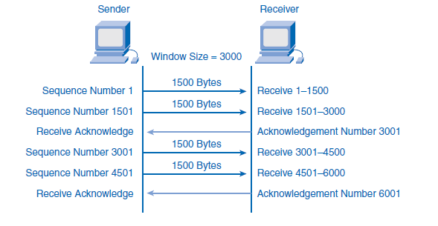
1. TCP: Communicating with Reliability
Outline

Slide 18
1. TCP: Communicating with Reliability
Outline
Dynamic Window Sizes
Another way to control the data flow is to use dynamic window sizes. When network resources are constrained, TCP can reduce the window size to require that received segments be acknowledged more frequently. This effectively slows the rate of transmission because the source must wait for data to be acknowledged. The TCP receiving host sends the window size value to the sending TCP to indicate the number of bytes that it is prepared to receive as a part of this session. If the destination needs to slow the rate of communication because of limited buffer memory, it can send a smaller window size value to the source as part of an acknowledgment.
After periods of transmission with no data losses or constrained resources, the receiver will begin to increase the window size field. This reduces the overhead on the network because fewer acknowledgments need to be sent. Window size will continue to increase until data loss occurs, which will cause the window size to be decreased. This dynamic increasing and decreasing of window size is a continuous process in TCP, which determines the optimum window size for each TCP session. In highly efficient networks, window sizes can become very large because data is not being lost. In networks where the underlying infrastructure is being stressed, the window size will likely remain small.

Slide 19
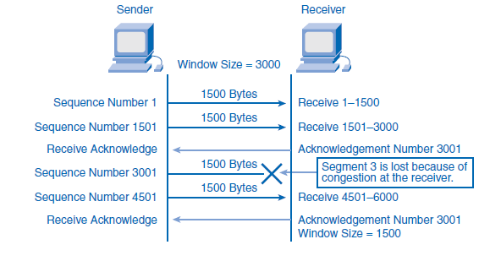
1. TCP: Communicating with Reliability
Outline

Slide 20
2. UDP: Communicating with Low Overhead
Outline
UDP is a simple protocol that provides the basic transport layer functions. It has much lower overhead than TCP, because it is not connection oriented and does not provide the sophisticated retransmission, sequencing, and flow control mechanisms.
Because UDP has low overhead and does not provide the functionality that TCP provides for reliability, care must be taken when you choose to use UDP.
Applications that use UDP are not always unreliable. Using UDP simply means that reliability is not provided by the transport layer protocol and must be implemented elsewhere if required. Some applications, such as online games or VoIP, can tolerate loss of some data. If these applications used TCP, they might experience large delays while TCP detects data loss and retransmits data. These delays would be more detrimental to the application than small data losses. Some applications, such as DNS, will simply retry the request if they do not receive a response, and therefore they do not need TCP to guarantee the message delivery. The low overhead of UDP makes it desirable for such applications.

Slide 21
2. UDP: Communicating with Low Overhead
Outline
UDP Datagram Reassembly
Because UDP is connectionless, sessions are not established before communication takes place as they are with TCP. UDP is transaction based. In other words, when an application has data to send, it simply sends the data. Many applications that use UDP send small amounts of data that can fit in one segment. However, some applications will send larger amounts of data that must be split into multiple segments The UDP PDU is referred to as a datagram, although the terms segment and datagram are sometimes used interchangeably to describe a transport layer PDU. When multiple datagrams are sent to a destination, they can take different paths and arrive in the wrong order.
UDP does not keep track of sequence numbers the way TCP does. UDP has no way to reorder the datagrams into their transmission order. Therefore, UDP simply reassembles the data in the order that it was received and forwards it to the application. If the sequence of the data is important to the application, the application will have to identify the proper sequence of the data and determine how it should be processed.

Slide 22
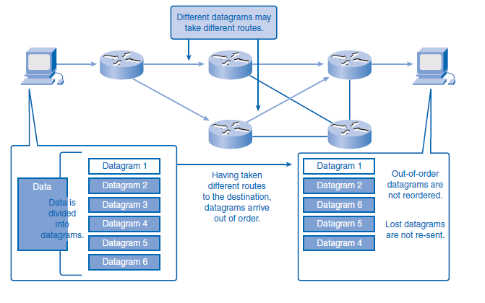
2. UDP: Communicating with Low Overhead
Outline

Slide 23
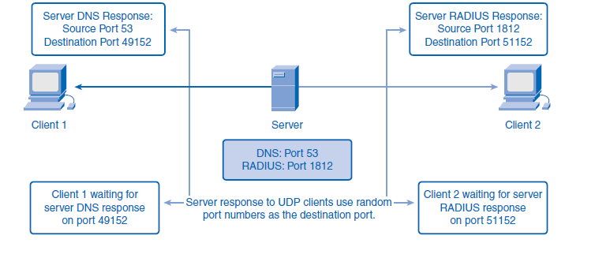
2. UDP: Communicating with Low Overhead
Outline
UDP Server Processes and Requests
Like TCP-based applications, UDP-based server applications are assigned well-known or registered port numbers. When these applications or processes are running, they will accept the data matched with the assigned port number. When UDP receives a datagram destined for one of these ports, it forwards the application data to the appropriate application based on its port number.
As with TCP, client/server communication is initiated by a client application that is requesting data from a server process. The UDP client process randomly selects a port number from the dynamic range of port numbers and uses this as the source port for the conversation. The destination port will usually be the well-known or registered port number assigned to the server process.

Slide 24


THANK YOU

